Slide 1
Yelp Restaurant Recommendation Model
EECE 5698
Spring 2019
Sai Sneha Yachamaneni
Kuan-Chih Lee

Slide 2
Introduction
For diners, the decision of selecting a restaurant in the location they are is often very confusing process
In a recent survey conducted, it’s been shown that 94% of diners will choose restaurants based on online reviews
Yelp is very good at providing this kind of recommendations

Slide 3


Problem Statement
Yelp is one of the mostly used service by the citizens of the USA for providing business reviews with their own experience
Yelp helps businesses like restaurants, hotels etc to establish their business page on their website
Our project is to build a Restaurant Recommendation Model using dataset provided by Yelp_Data_Challenge

Slide 4
Data Preparation
Below are the json files which we have used in our project
Perform inner join based on business_id between review and business
Filter records based on location, extract records where state is Nevada
Review.json | Contains full review text data including the user_id that wrote the review and the business_id the review is written for
Business.json | Contains business data including location data, attributes, and categories

Slide 5
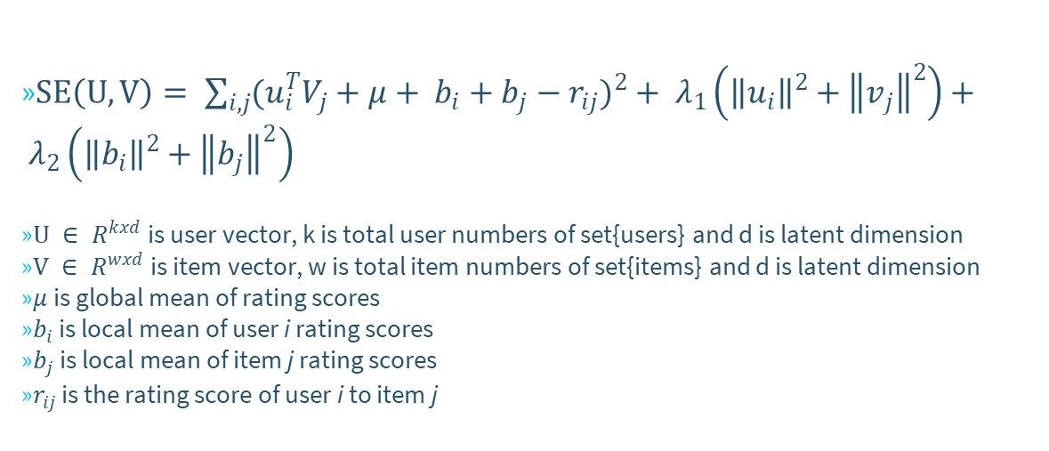
Proposed Methods
$SE\left(U,V\right)= \sum_{i,j}{{(u_{i}^{T}V_{j}+μ+ b_{i}+b_{j}−r_{ij})}^{2}}+ λ_{1}\left({\left\|u_{i}\right\|}^{2}+{\left\|v_{j}\right\|}^{2}\right)+ λ_{2}\left({\left\|b_{i}\right\|}^{2}+{\left\|b_{j}\right\|}^{2}\right)$
$U ∈ R^{kxd}$ is user vector, k is total user numbers of set{users} and d is latent dimension
$V ∈ R^{wxd}$ is item vector, w is total item numbers of set{items} and d is latent dimension
$μ$ is global mean of rating scores
$b_{i}$ is local mean of user i rating scores
$b_{j}$ is local mean of item j rating scores
$r_{ij}$ is the rating score of user i to item j

Slide 6
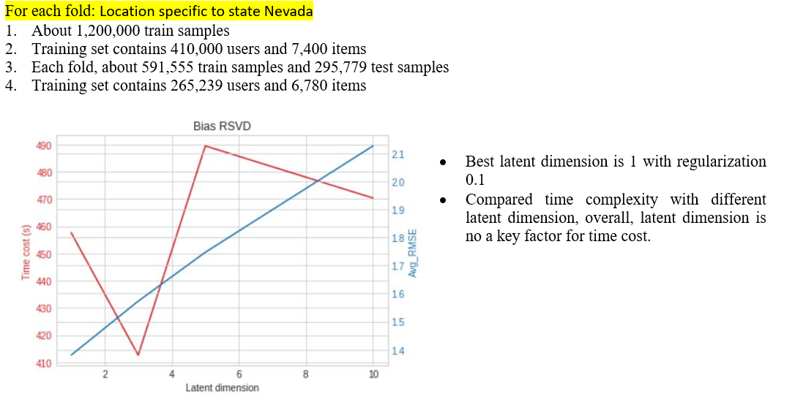
Case I: Bias RSVD With 6 Machines

Slide 7
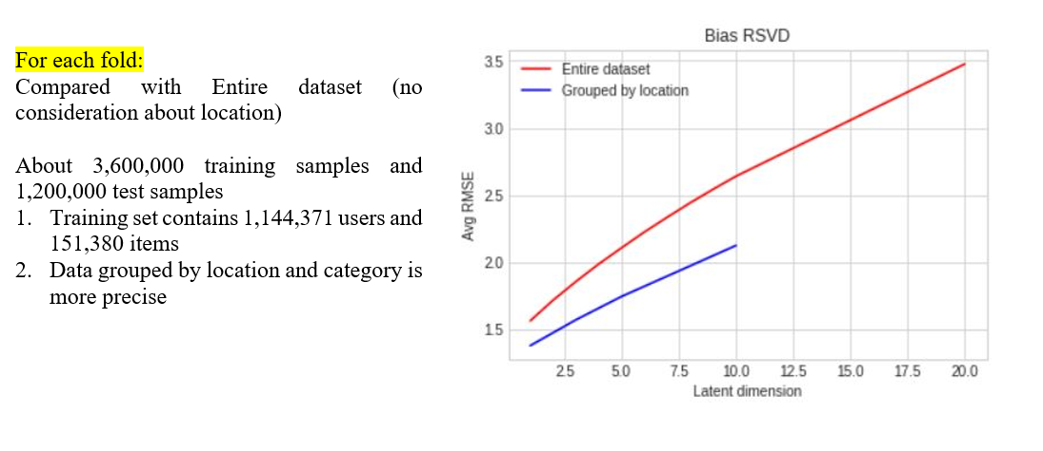
Location Matter??
(Entire USA)
(Nevada)

Slide 8
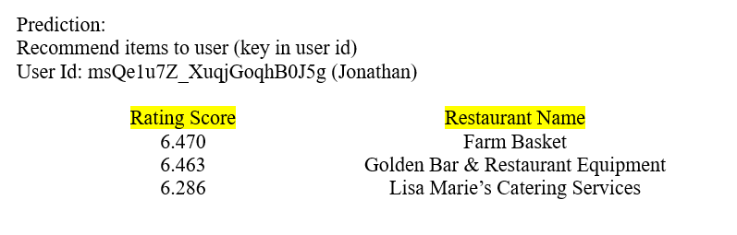
Predictions

Slide 9
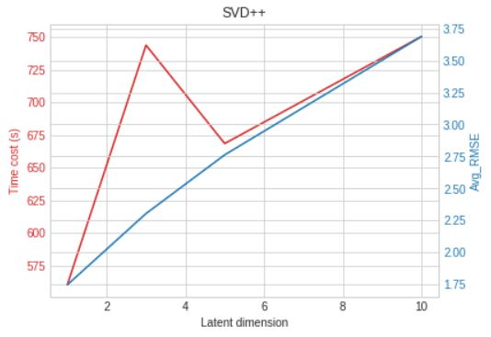
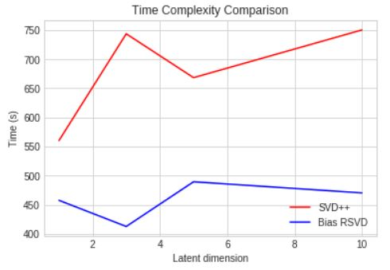
Case II: SVD++ With 6 Machines
Time cost is a big issue for SVD++ !!

Slide 10
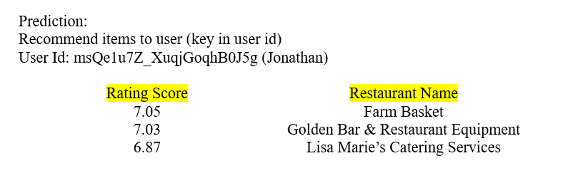
Predictions

Slide 11
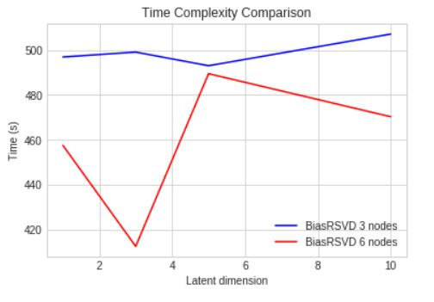
Case III: Bias RSVD With 3 Machines
1. 6 nodes is better than 3 nodes
2. Using single local model, program will crash because of space issue!
3. Communication issue as requesting more nodes??

Slide 12
Conclusions
SVD++ is more time cost than Bias-RSVD model
This project implements two different SVD based models as well as
leverages the power of parallelism between interactive and local mode.
Grid search is expensive especially for big dataset
Geography information is a good feature and is effective to improve
accuracy.
6 nodes parallelism is better than 3 nodes parallelism, and single local model will crash program.

Slide 13
References
Reference
https://www.yelp.com/dataset/documentation/main
https://www.cs.rochester.edu/twiki/pub/Main/HarpSeminar/Factorization_Meets_the_Neighborhood-_a_Multifaceted_Collaborative_Filtering_Model.pdf

Slide 14
Thank You

